Slide 1
Smart Editor
#AICTE5
Team SUDOS
Simraj Bhojwani
Harsh Jain
Nausheen Sayed
Riya Kariya
Vishal Israni
Abid Inamdar

Slide 2
Problem Statement
Smart editor: A tool for fetching and editing information from scanned document mainly image type.
Ministry/State : AICTE

Slide 3
Solution
Tech Stack
To use OCR (Optical Character Recognition) Toll
Detect Handwritten / Printed text and convert it into editable format
Implement PDF to word conversion
GUI : Tkinter
Backend
Image Processing : Opencv
Training Model : Python, Keras

Slide 4
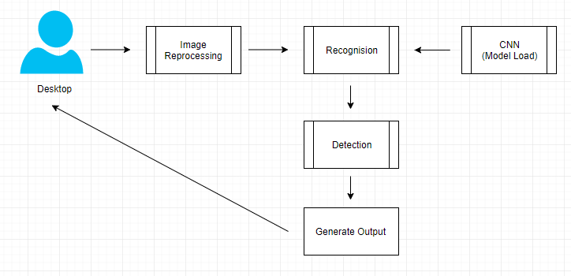
Desktop Application

Slide 5
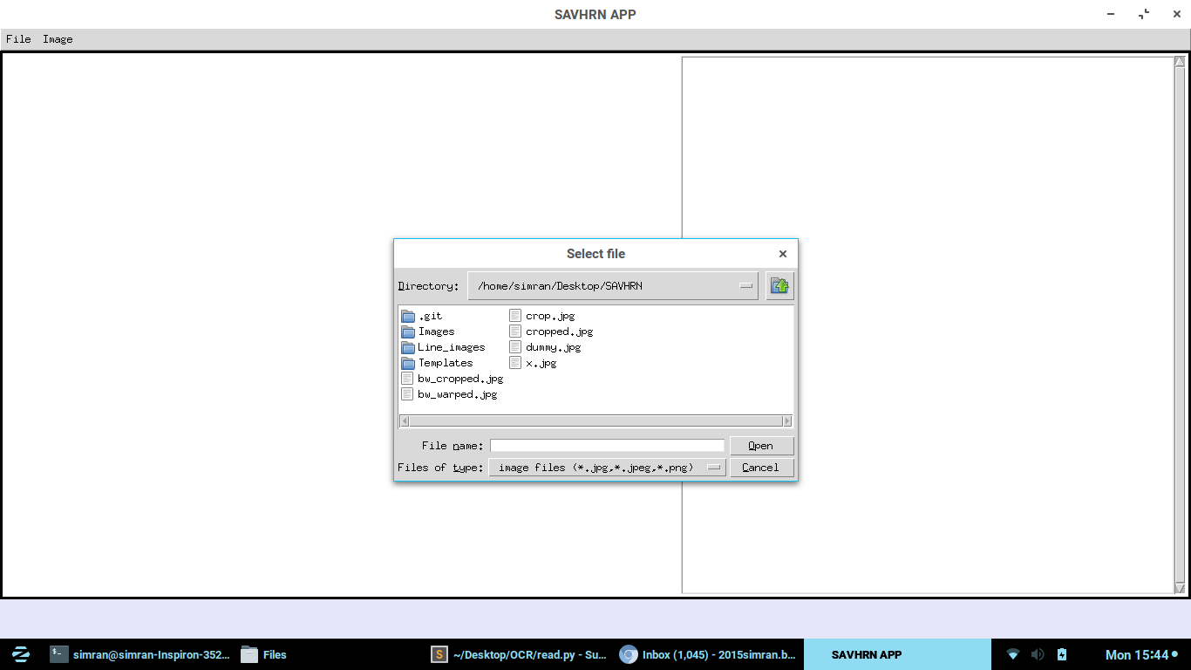
Screenshots

Slide 6
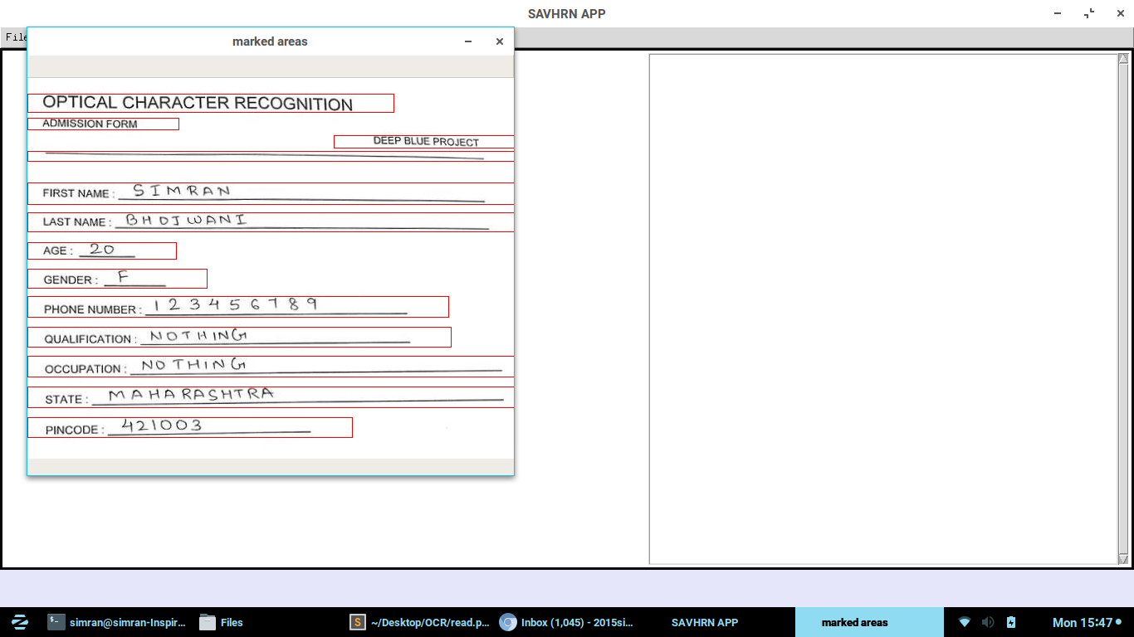

Slide 7
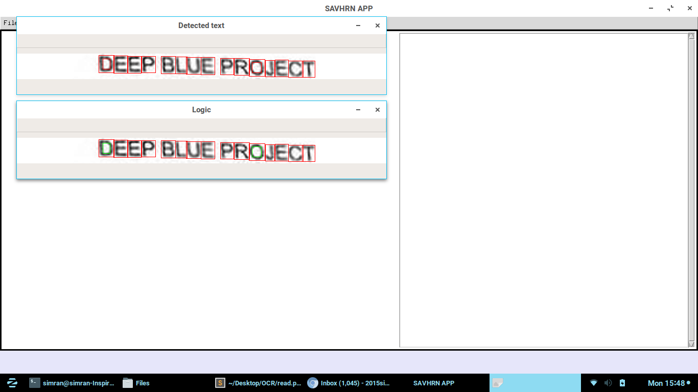

Slide 8
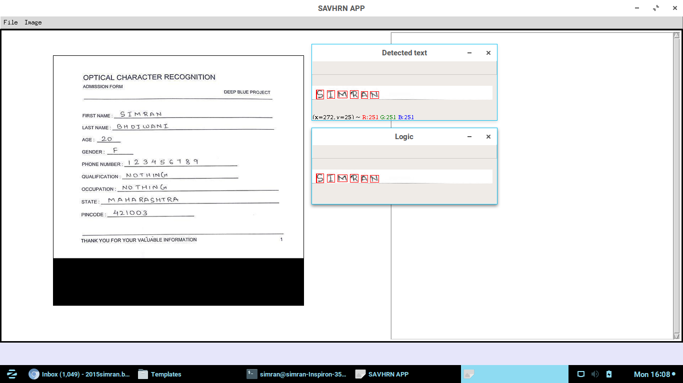

Slide 9
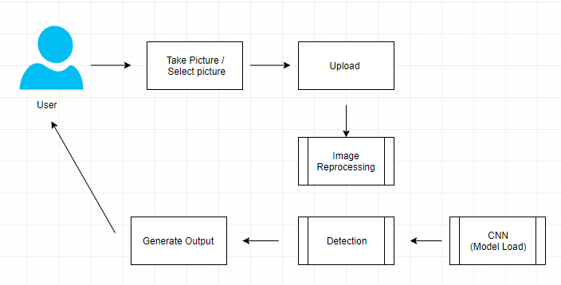
Android App / Website Workflow

Slide 10
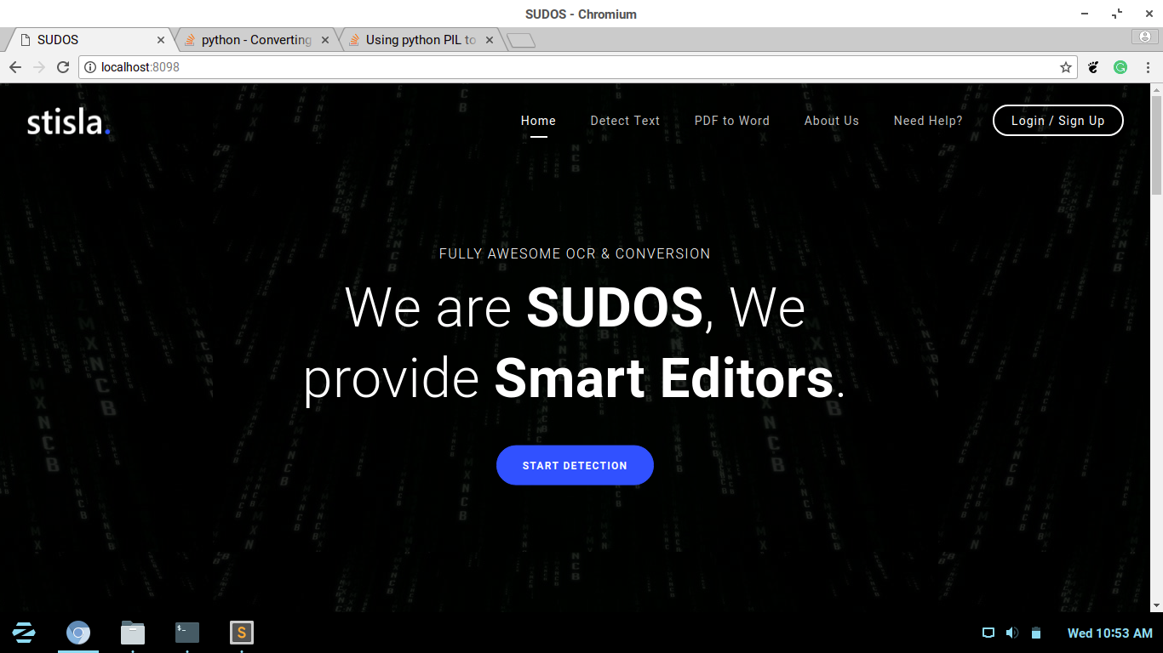

Slide 11
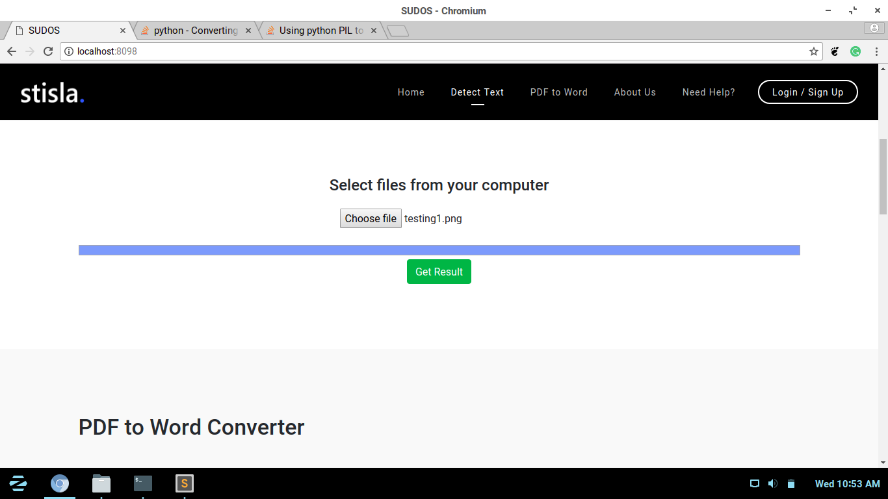

Slide 12
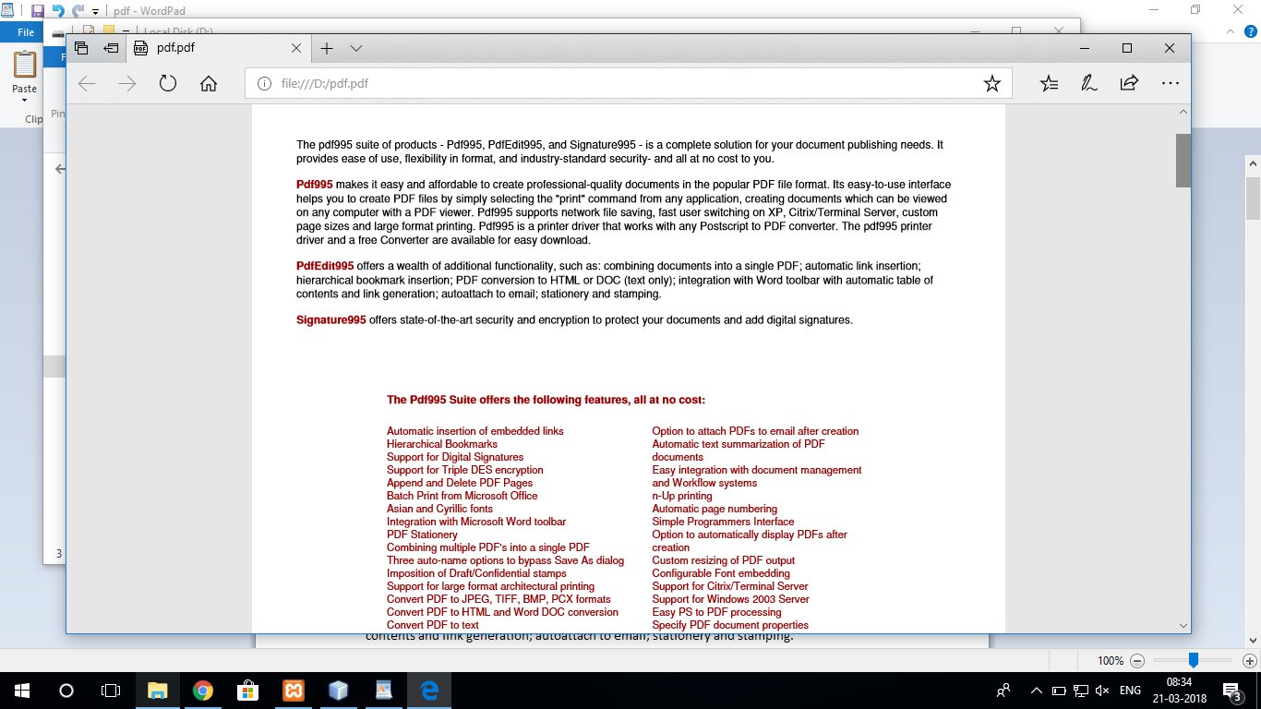

Slide 13
